Slide 1

Neural Networks
Active Learning

Slide 2
Active Learning (Semi-Supervised Learning)
Notes:
Relatie tot Transfer learning: active learning is een andere approach om toch met minder data een goed deep learning model te maken. Hiervoor moet je wel goede learners gebruiken uit je dataset…

Slide 3
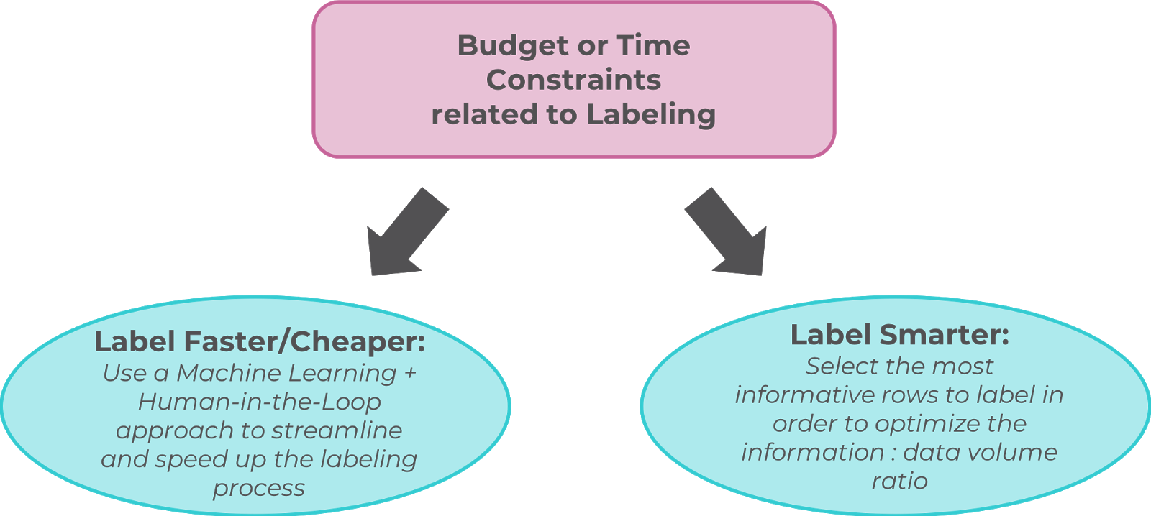
Need for (correctly) Labeled Dataset: ‘Go Fast’, or, ‘Go Smart’? (labeling data at scale challenge)
Notes:
Labeling smarter: big data challenge: how do you label vasts amounts of data? You need to be smart about it. You don’t even need to label everything, just the most important, most informative samples, so you can learn the fastest, with the least amount of data…
Good talk about Active Learning:
https://www.datacouncil.ai/talks/active-learning-why-smart-labeling-is-the-future-of-data-annotation?hsLang=en
https://www.youtube.com/watch?v=riSCBXozTHA

Slide 4
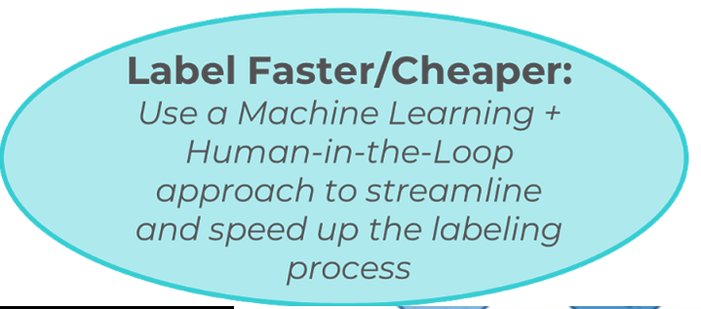

Notes:
Label fast – Human in the loop

Slide 5
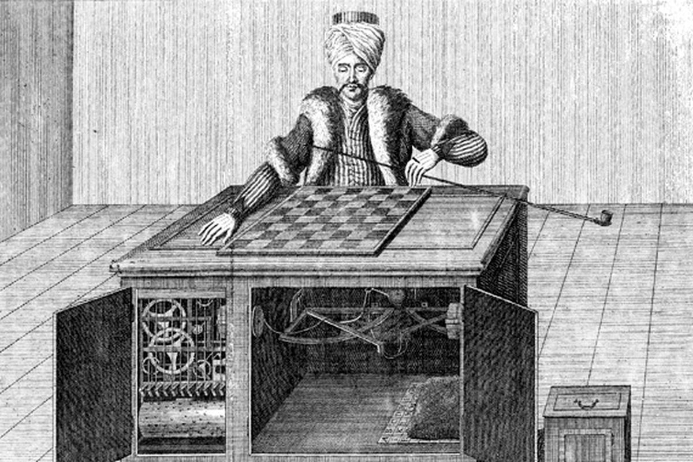
Notes:
Label Fast - Amazon Mechanical Turk: human in the loop

Slide 6
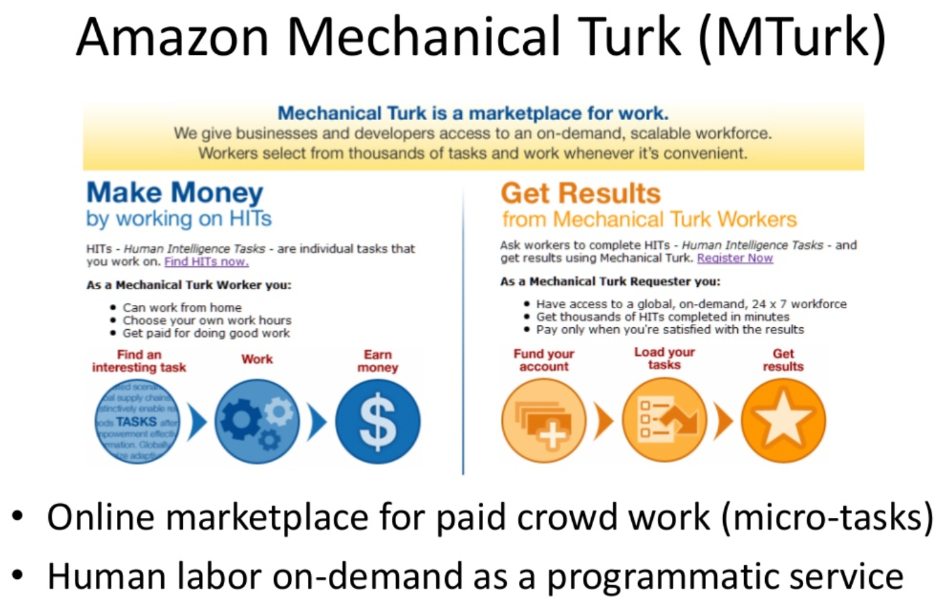

Slide 7
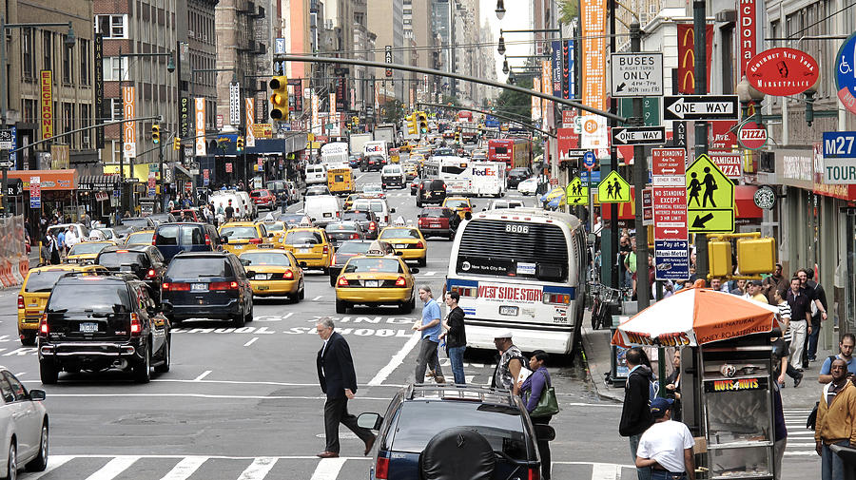
Go Fast problems: Human Labeling? Volume Problem?
~20 cars
x 10 seconds of video
x 30 frames per second
~ 1h40 for labeling of 10s video at 1 box/second
30 frames / second
Notes:
Human labelling is soms gewoonweg te traag.
Er is teveel data, of de data is te ‘rich’. Zeker bv bij multi-labelling van data.
En als er zo veel data te labellen is, hoe zit het met de quality van de labels? Want geef een mens een redelijk repetitieve taak, en men wordt al snel bored, en gaat fouten maken…

Slide 8
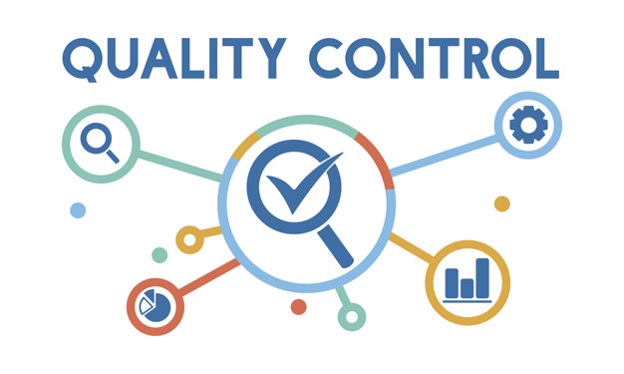
AI + Human-in-the-Loop Approach
Possible solution:
Bulk of labelling by ML/AI, QA by human
Algorithm also learns fromQA’s feedback
= a form of ‘Active Learning’
“Fixed” by human annotator / QA
Notes:
Mix between go fast, and human in the mix…AI/ML assisted labelling
Bij (multi-)labelling kan de AI voorstellen doen qua labelling.
De mens dient dan als quality control (geen super repetitieve taak meer).
Die quality feedback loop kan door het algorithme dan weer gebruikt worden om betere labelling in de toekomst (of voor de andere unlabelled data) te gaan voorstellen. Dit is een algmene vorm van Active Learning, semi-supervised learning.

Slide 9
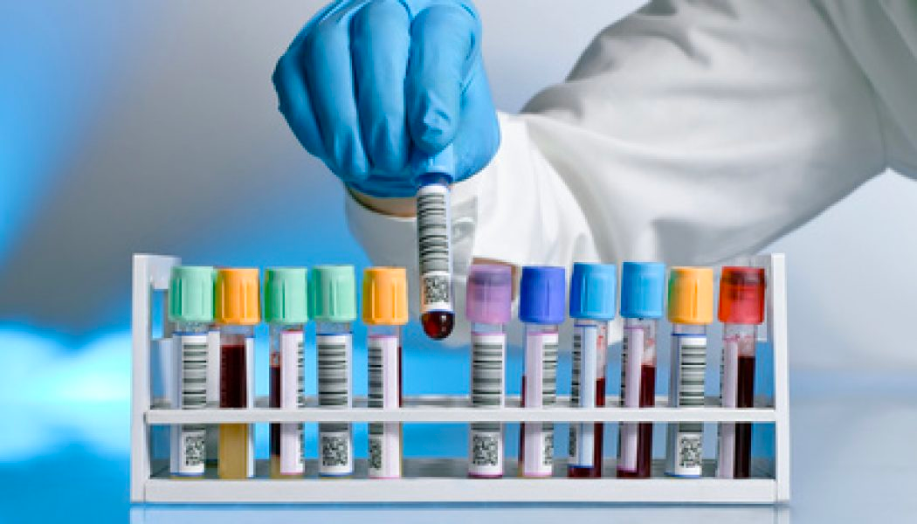
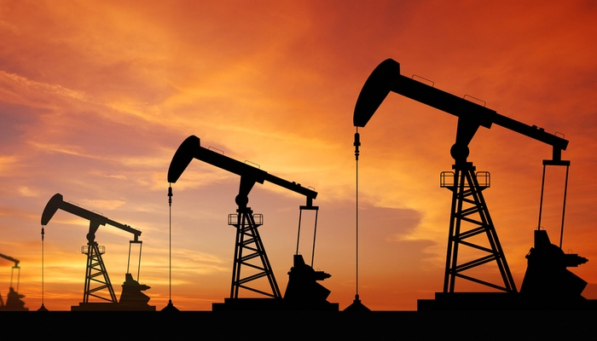

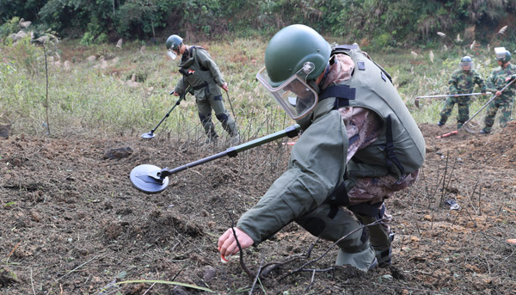
Labeling Data can be…
Even single annotations can be:
Hard to obtain
Expensive
Time-Consuming
Dangerous
Notes:
But, sometimes, going fast isn’t an option. Some data might be hard to obtain (for instance drawing blood samples, sending it to the lab, getting contents back), or very expensive (finding new oil drilling sites: if you want to check your prediction → very expensive to drill a well), time-consuming (getting lots and lots of legal documents, but you only need a part), or very dangerous (finding land mines)

Slide 10
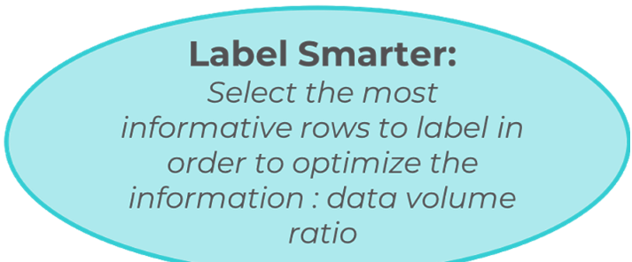
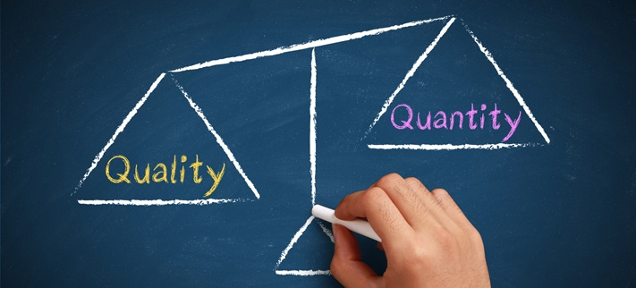

Slide 11
Stages of Semi-Supervised Learning
Once & for all
Before Training
During Training
After Training
Entire Dataset Labeling
Active Learning
Manual Override
Prioritizer
Semi-Supervised Learning
Prioritize: before training, hand pick good learners (preliminary assumptions)
Active Learning: choose which data you want to label next (quering strategy), while training your model (select data that is usefull to your model, pick the data that is specifically designed to fit your model)
Manual Override: ‘human-in-the-loop’ approach, when confidence is too low, manually check, and override the label
Notes:
Active Learning gaat dus vooral zelf voorstellen welke data items het best eerst gelabelled kunnen worden (via de quering strategy) om zo de best mogelijke resultaten te bekomen

Slide 12
Active Learning: example
Unlabeled data

Slide 13

Active Learning: example
Human “oracle”
Initial sample
Notes:
Human oracle selects most promising initial samples to learn from. Human oracle can be domain expert, but you can also use metrics to choose most promising, most informative, samples (entropy, distance from mean image, mean clustering techniques,… or just at random – but less ‘smart’)
Hyper-parameter: how many samples to pull?

Slide 14
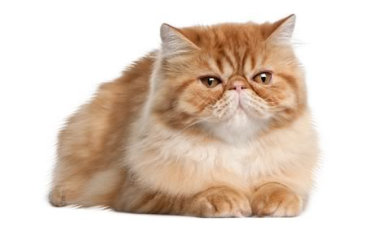
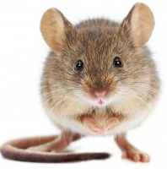
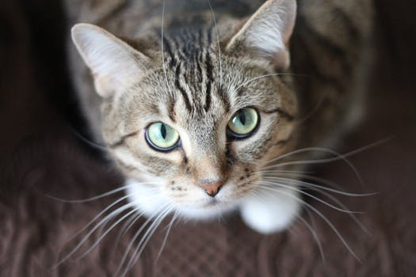
Active Learning: example
Initial sample, labeled
Notes:
Human oracle will label those most promising samples

Slide 15
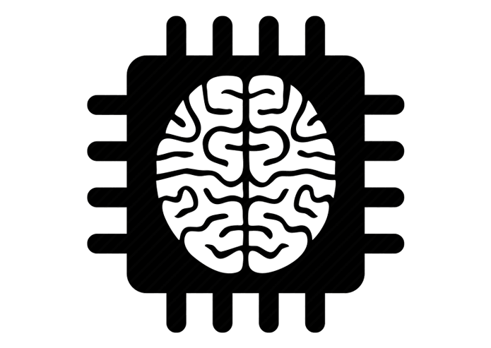
Active Learning: example
Model training
Learning agent
Notes:
Train your model on those samples

Slide 16
Active Learning: example
60% accuracy
Notes:
You will get a reasonably high accuracy, if you chose most promising, informative, samples

Slide 17
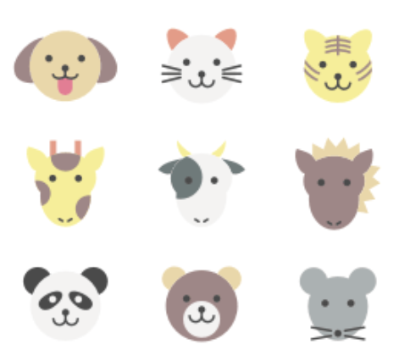
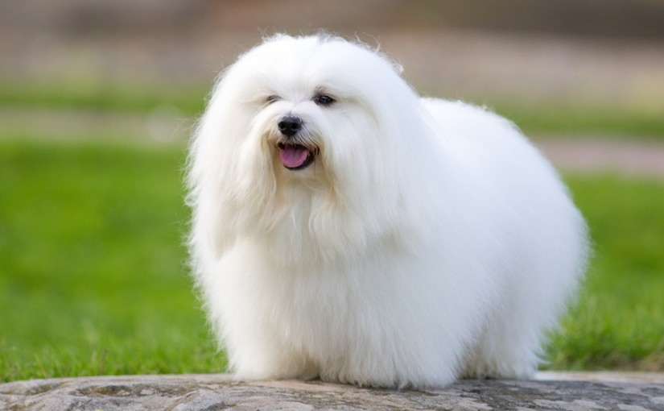
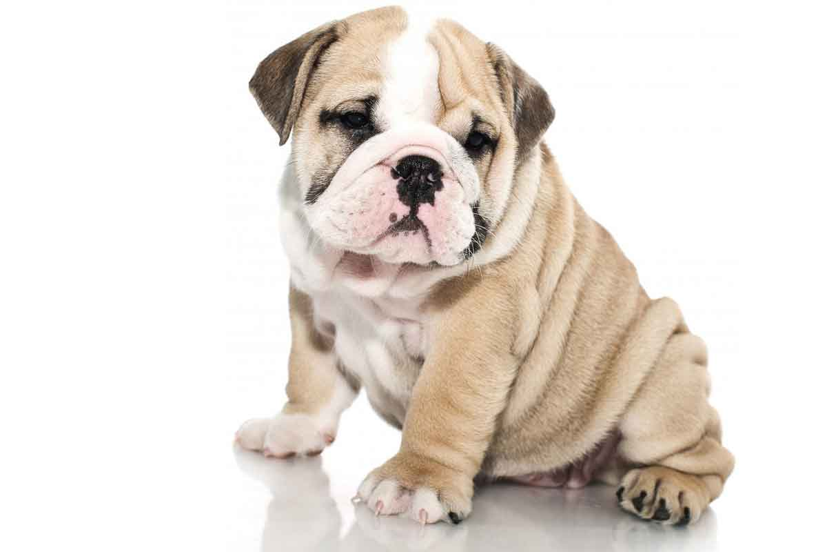
Active Learning: example
Inferred labels on remaining data
60% accuracy
Notes:
Now, use your model to infer labels on the ‘unlabeled dataset’. Now you will have other metrics to choose your next-round most-informative samples, like ‘meta data’: for instance the confidence your model gave you during inference, margins between your top-5 predictions, entropy calculations,…

Slide 18
Active Learning: example
Sample selected using querying strategy
60% accuracy
Notes:
Select next round of most promising new samples from your ‘meta-data’ collected during inference.
This part, the querying strategy is most difficult part of active learning…
Usually, confidence levels are used to determine which ones are chosen. Too high is not chosen, because model already knows these. Too low confidence is also probably not a very good choice, because these might be ‘spam’, or ‘bad’ samples, samples with little to no good information to use,…or…they might just be the ones your model is really bad at classifying…so they might actually sometimes be (really) usefull…

Slide 19
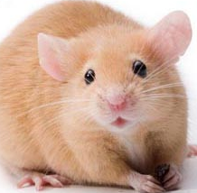
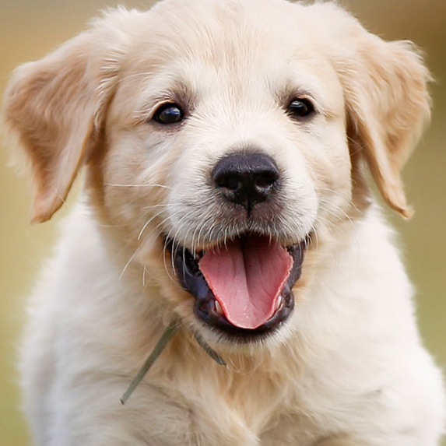

Active Learning: example
60% accuracy
Notes:
Correctly label those next round most promising samples

Slide 20
Active Learning: example
Model training
60% accuracy
Notes:
Train some more with those new examples to get higher accuracy model

Slide 21
Active Learning: example
90% accuracy
Notes:
Repeat proces of inferencing (now with higher accuracy model), select most promising samples,… → until you run out of time / money / samples

Slide 22
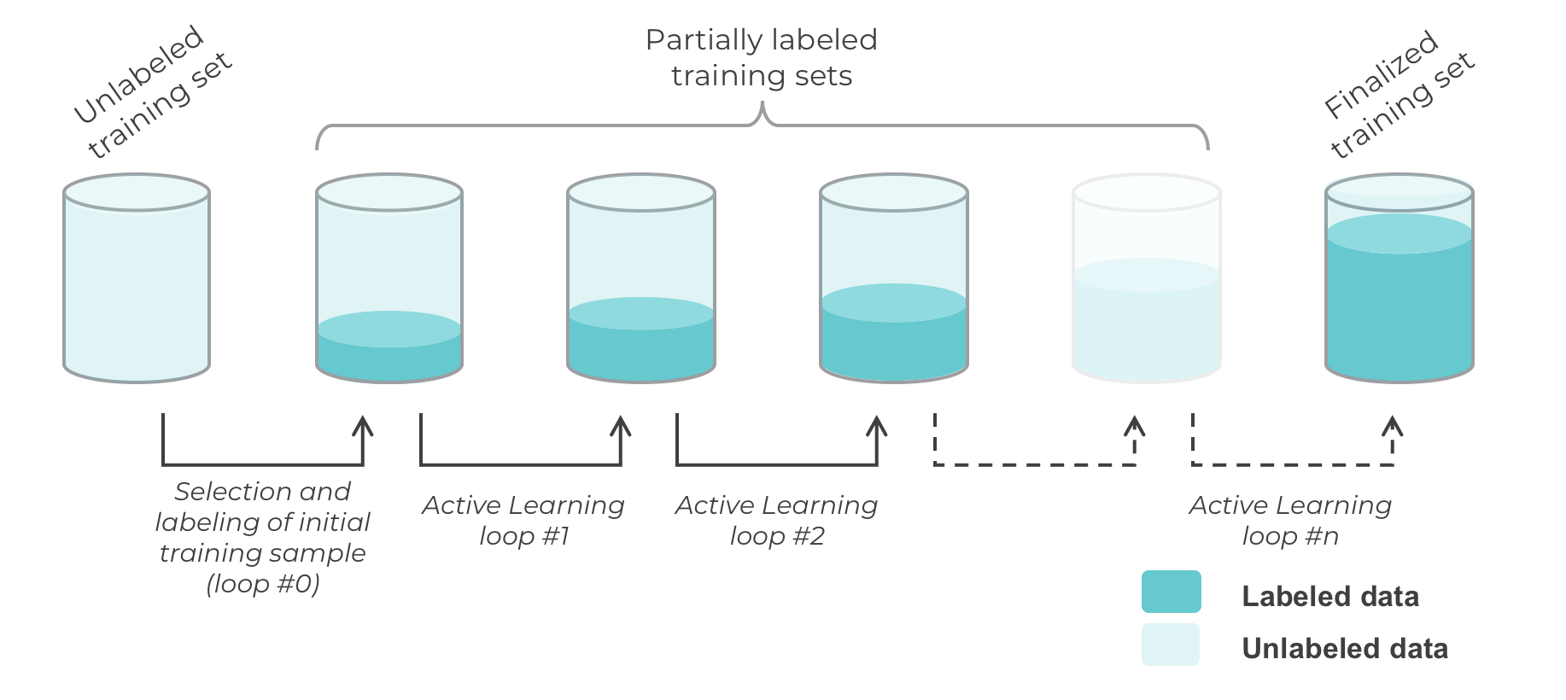
Active Learning cycles

Slide 23
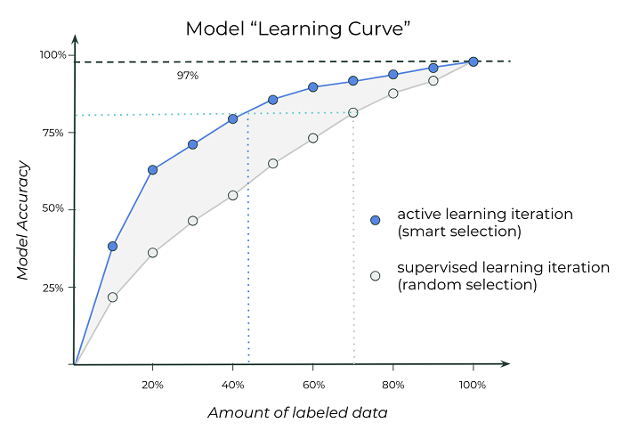
Go Smart… Learn From the Best…
Notes:
Learn from the best, most informative samples first…
This will give you a much steeper learning curve

Slide 24
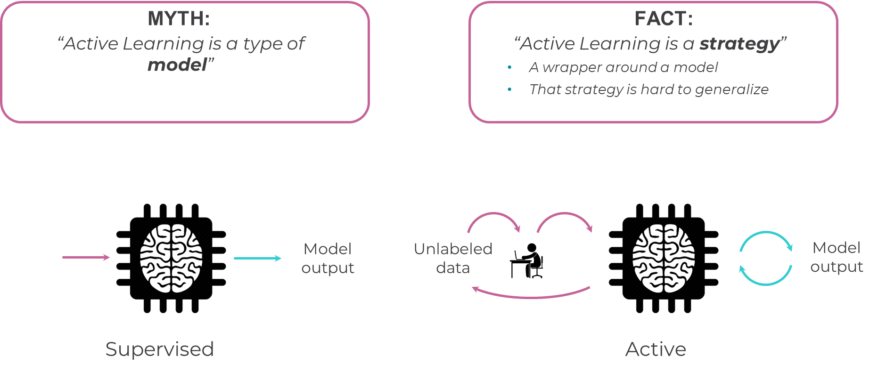

Slide 25
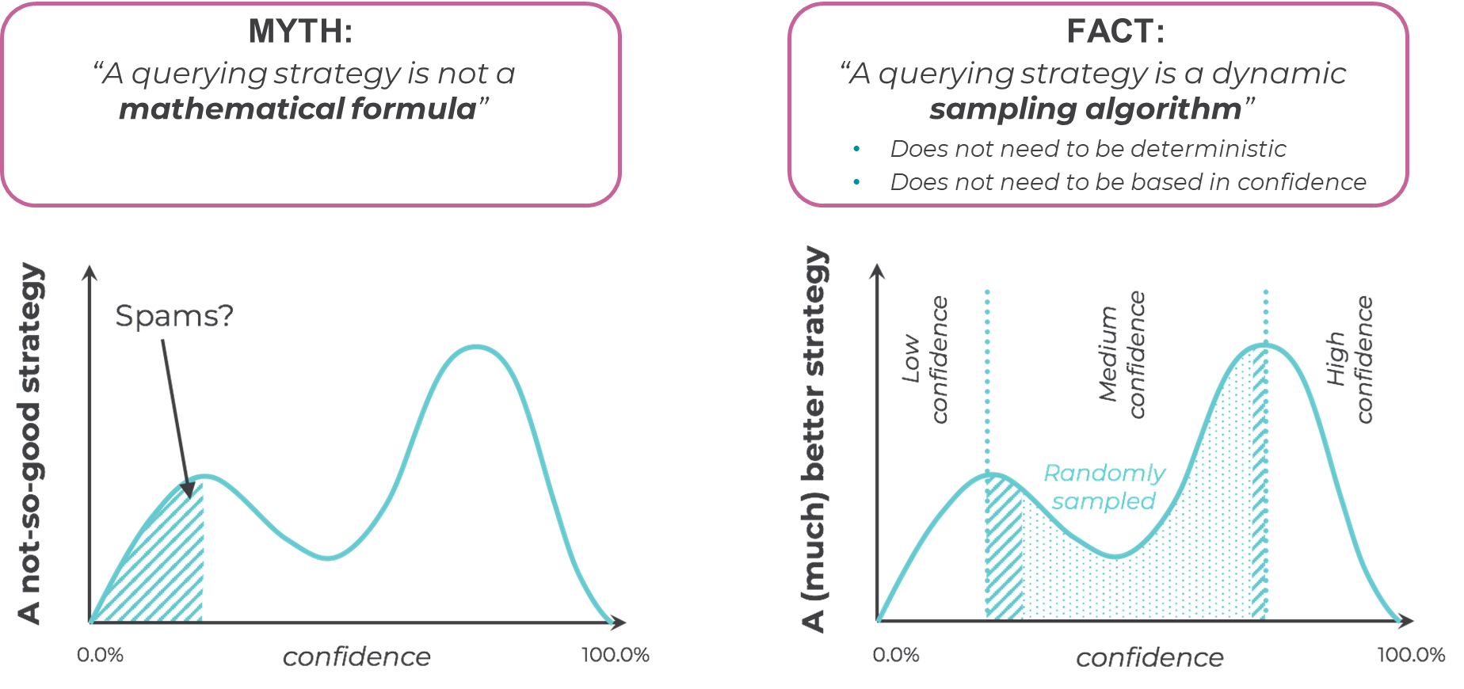

Slide 26
Model Distillation – special case of ‘transfer-active learning’
Notes:
More like ‘mimic’ learning

Slide 27
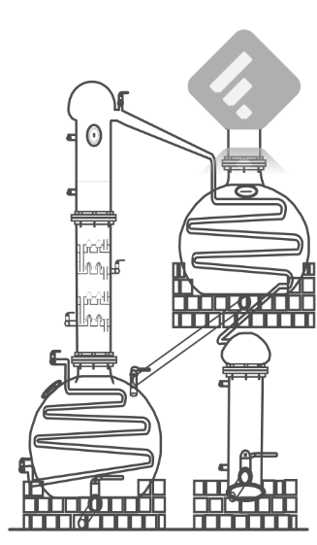
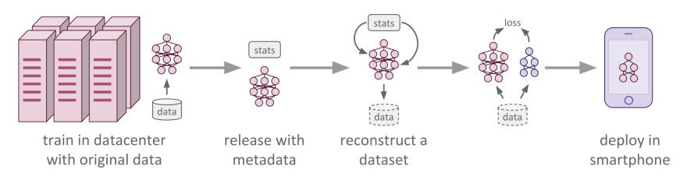
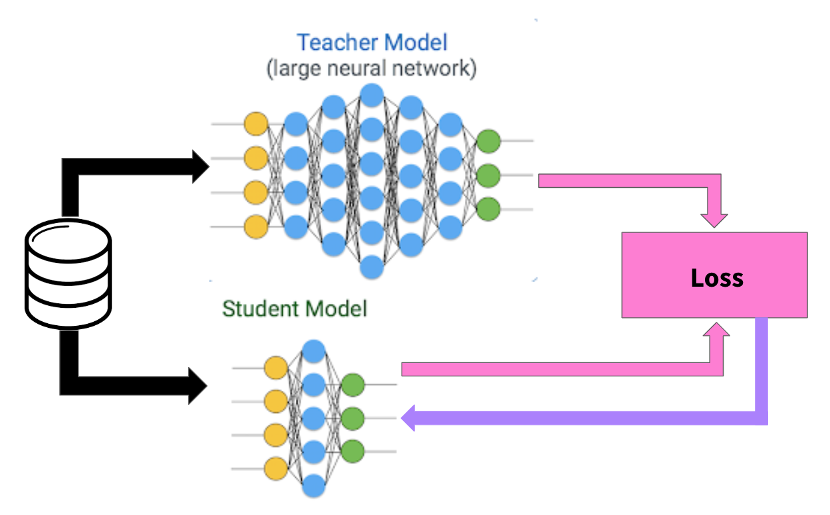
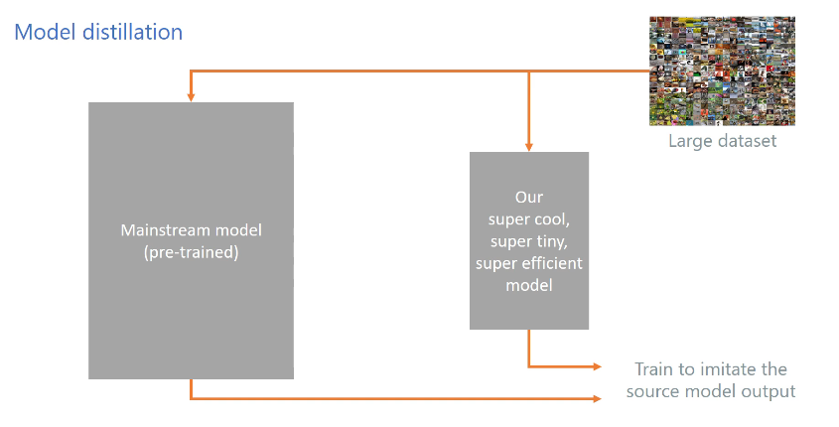
Notes:
Model distillation:
Stel dat we veel data hebben, maar we hebben niet de resources om zo veel te trainen, of deep model in memory te laden. We zouden dan de outputs, en dus niet de weights, noch alle data points (wel de meest zekere, meest informatieve), van een pre-trained model kunnen gebruiken, om ons netwerk te trainen. Dus eigenlijk trainen we ons nieuw netwerk om het grote teacher netwerk te ‘mimic’-en.
Zo kan je dus met een simpel netwerk de performance laten benaderen van een groot netwerk. Dit is dus ook een soort van regularisatie techniek
https://software.intel.com/en-us/articles/knowledge-distillation-with-keras?utm_source=ISTV&utm_medium=Video&utm_campaign=ISTV2018_ISTV1815

Slide 28
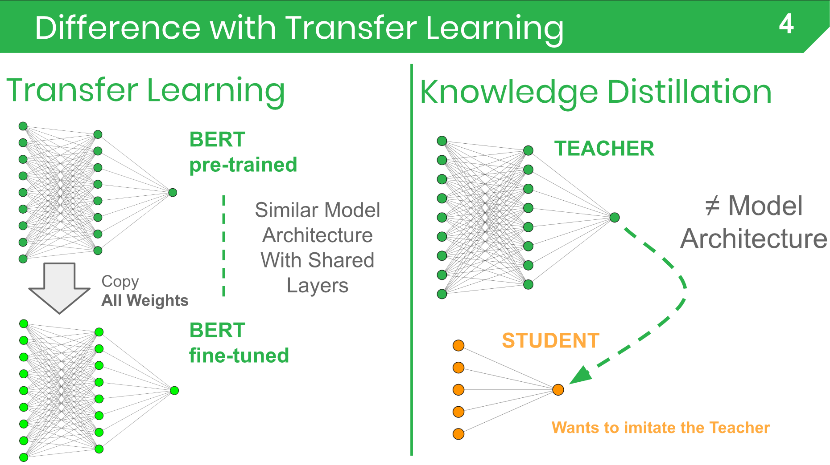
Notes:
https://blog.feedly.com/nlp-breakfast-8-knowledge-distillation/

Slide 29
Object Detection & Segmentation (next time)

Slide 30
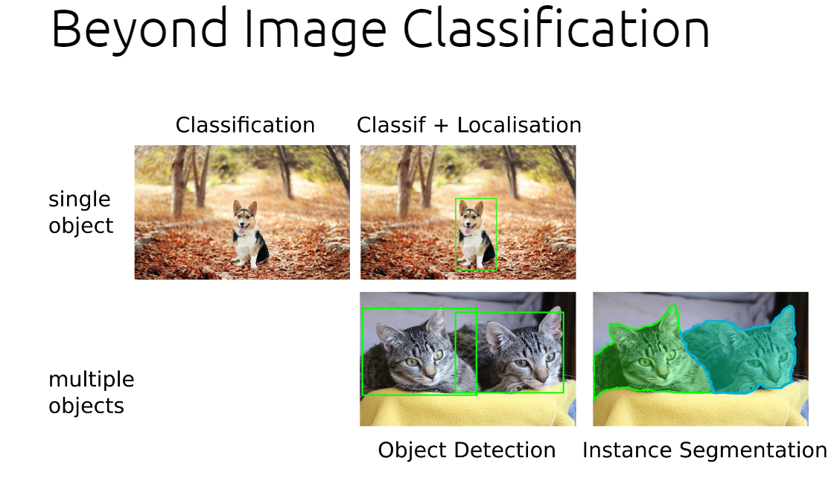

Slide 31
Object Detection and Segmentation
YOLO
SSD (single shot detector)
U-NET

